Slide 1



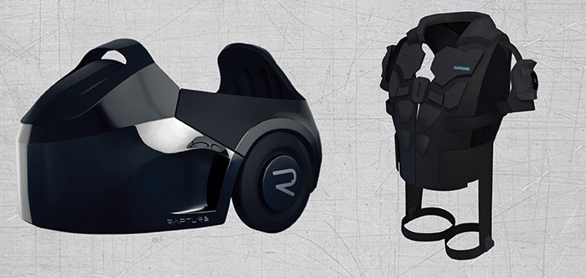

Slide 2

Vision of Infinite Dimensions
Whole body, fully immersive VR experience

Slide 3

History of The Void
The Void was co-founded by Ken Bretschneider, Curtis Hickman and James M.Jensen. Bretschneider focused on developing the void after he decided to stop Evermore project.
The Void is a spin-off of Evermore Park

Slide 4
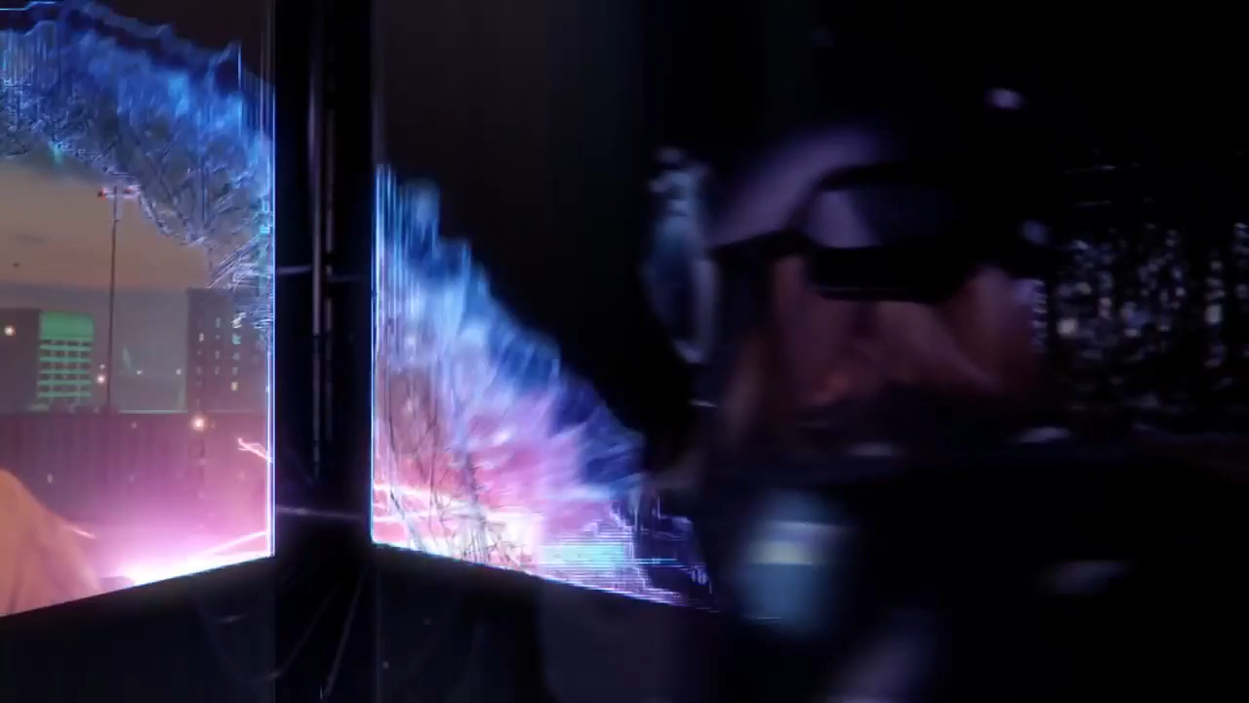

Slide 5
Why is it a good use of VR? Why is it unique? What’s cool about it?
The void built in LAN (local area network) environment avoiding latency issues.
It is unique cause it has hyper-reality experience hinge on a VR environment.
Promises full body tracking, weapon tracking and haptic feedback,
Realizes the vision of exploring infinite virtual worlds at 1:1 scale

Slide 6
a helmet with a head-mounted display
noise cancelling headphones and a hand tracking sensor,
and a haptic suit containing 22 vibrators and a computer to power the headset.
hones and a Leap Motion unit for hand tracking.
How does it work?

Slide 7
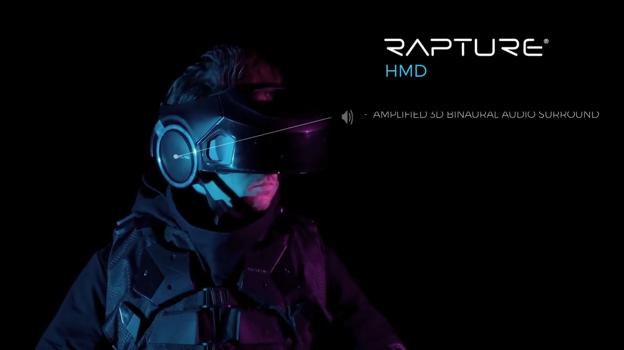
Technology

Slide 8
Where is it used? What are best suited applications?
The void is designed to allow the users to freely walk through and explore a virtual world.
For playing, education-oriented experience like police tranning and nature exploration.

Slide 9

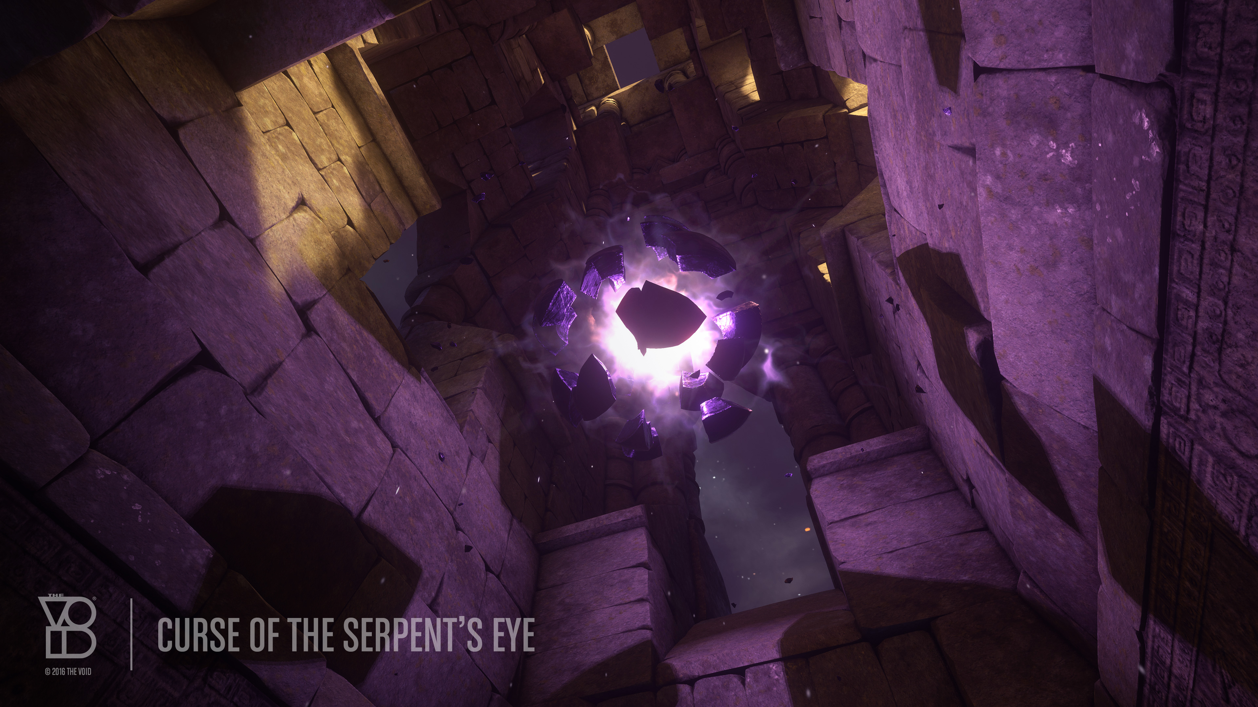

weaknesses
Ghostbusters:Dimension
The Curse of the Serpent’s Eye
star wars secrets of the empire

Slide 10
custom hardware and certain interactions, like ranged combat, aren’t quite ready yet
weaknesses

Slide 11
strengths
30-minute experience
price:$29.95

Slide 12
* Can this lead to varying degrees of simulator sickness including nausea, fatigue, headache, eyestrain, vertigo, and dizziness? * What is your rating on the scale from 0 to 10?
0: Normal (no motion sickness at all)
5: Average (lead to dizziness) -> can not use it for more than a few minutes
10: Max (can be dangerous)
0

Slide 13
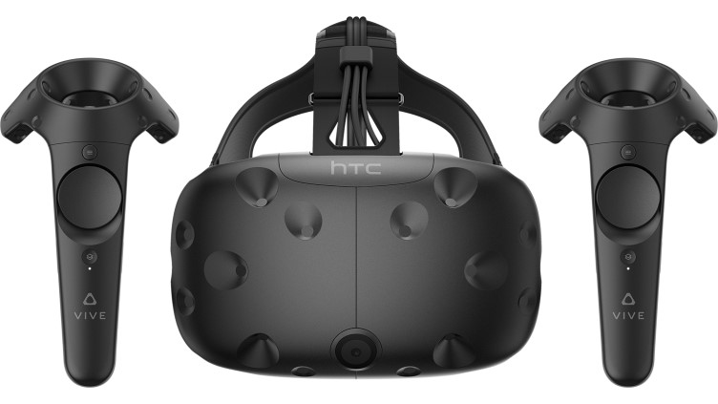
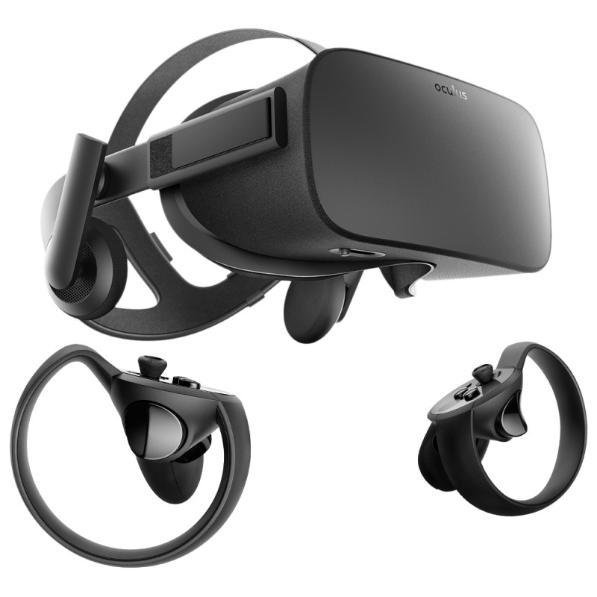
What are the similar/related applications?
HTC VIVE
Oculus Rift

Slide 14
Conclusion

Slide 15
Reference
https://www.technologyreview.com/s/544096/inside-the-first-vr-theme-park/
https://www.wired.com/2017/02/the-void-vr-game/
https://www.digitaltrends.com/computing/how-the-void-plans-to-put-reality-back-in-virtual-reality/
http://voicesofvr.com/284-beyond-room-scale-exploring-infinite-worlds-with-the-void/
http://www.ibtimes.com/virtual-reality-park-void-offers-unique-take-vr-experience-2523635/
https://www.theverge.com/2017/10/11/16456838/star-wars-secrets-of-the-empire-virtual-reality-tickets-the-void
https://blog.thevoid.com/welcome-hyper-reality-void/?_ga=2.21098558.425564302.1521407458-122398979
5.1517097141

